Slide 1
writing about myself
8 grade= presenter: ido bar shmuel

Slide 2
My hobbies: in my free time, I like to play football, talk to my friends, and play on the playstation.
Playing football is very important to me because it helps my body stay strong and healthy. I also enjoy talking with my friends because it makes me feel happy and relaxed.
Playing on the playstation is fun and helps me rest after a long day.

Slide 3
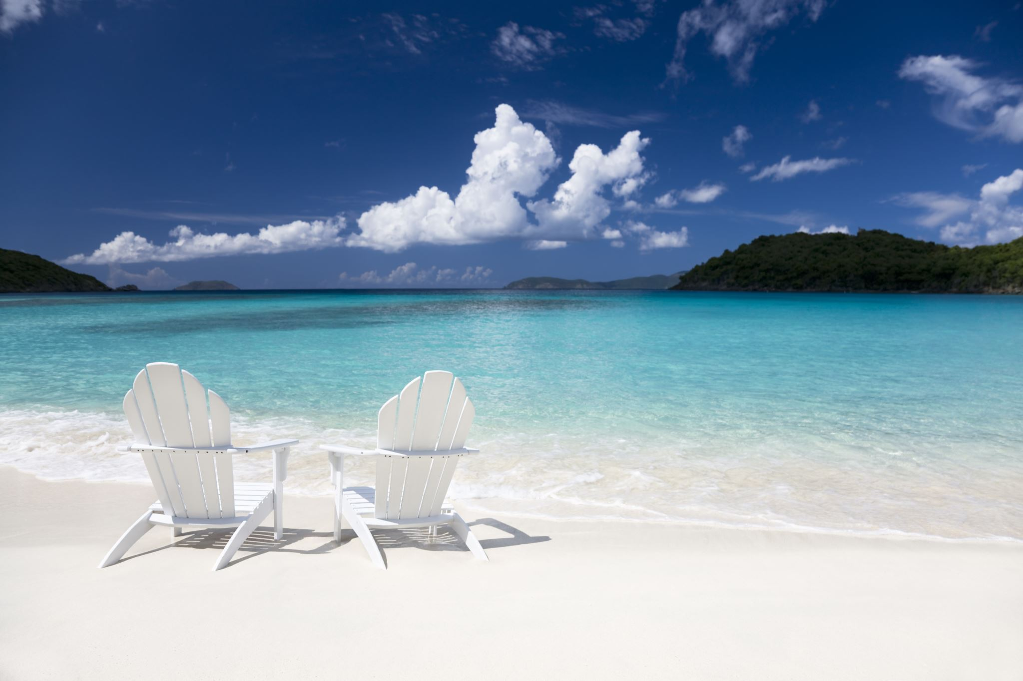
Details about me:
I have one brother and one sister. I play football for Maccabi jaffa kabilio.
This year I traveled to Thailand, where I visited Phuket, koh samui, koh phangan, and koh phi phi. During my trip, I enjoyed the beaches, the warm weather, and the local culture.
Traveling to Thailand was a special experience for me and helped me learn about new places and people.

Slide 4
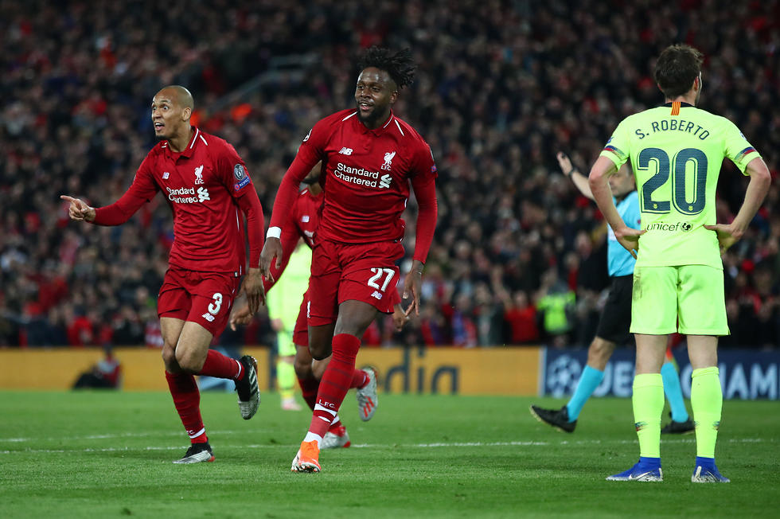
My dream: my dream is tobecome a professional football player.
I practice every day to get better and stronger.
Football makes me happy and gives me motivation.
I hope to play for a big club in the future.

